Slide 1
PHYS 449/773 Final Project Presentation
GALAXY CLASSIFICATION
Group Members: Yusuf Ahmed, Alexander Caires, Jordan Ducatel, Ashley Ferreira, Guillaume Hewitt
Notes:
General notes:
20 minutes + 10 min discussion
Presented on zoom?

Slide 2
TABLE OF CONTENTS
01.
02.
03.
04.
05.
INTRO + REVIEW
FOCUS
RESULTS
CONCLUSIONS
OUTLOOK
Notes:
BACKGROUND ON PROJECT PAPER
WHAT WE DECIDED TO REPRODUCE (AND A MENTION OF WHAT WE DIDN’T) - MENTION SAME AS MIDTERM PLAN +C1
Mention our main struggles

Slide 3
01. INTRODUCTION
Notes:
· ALEX
What is the problem tackled by your paper?
· The computational challenge the paper intends to overcome using ML
· Why CNN?
If the code of the project is available on Github or elsewhere, you must mention this in your presentation and explain how you plan to interact with that code. Will you completely ignore that code? Will you be using any parts of it to guide your development? Are you planning to develop code from scratch and/or to use alternative/improved software design compared to the existing code? How would differences between the results you'd be reproducing and what is produced in the paper play a part here? Give a justification to each such consideration.

Slide 4
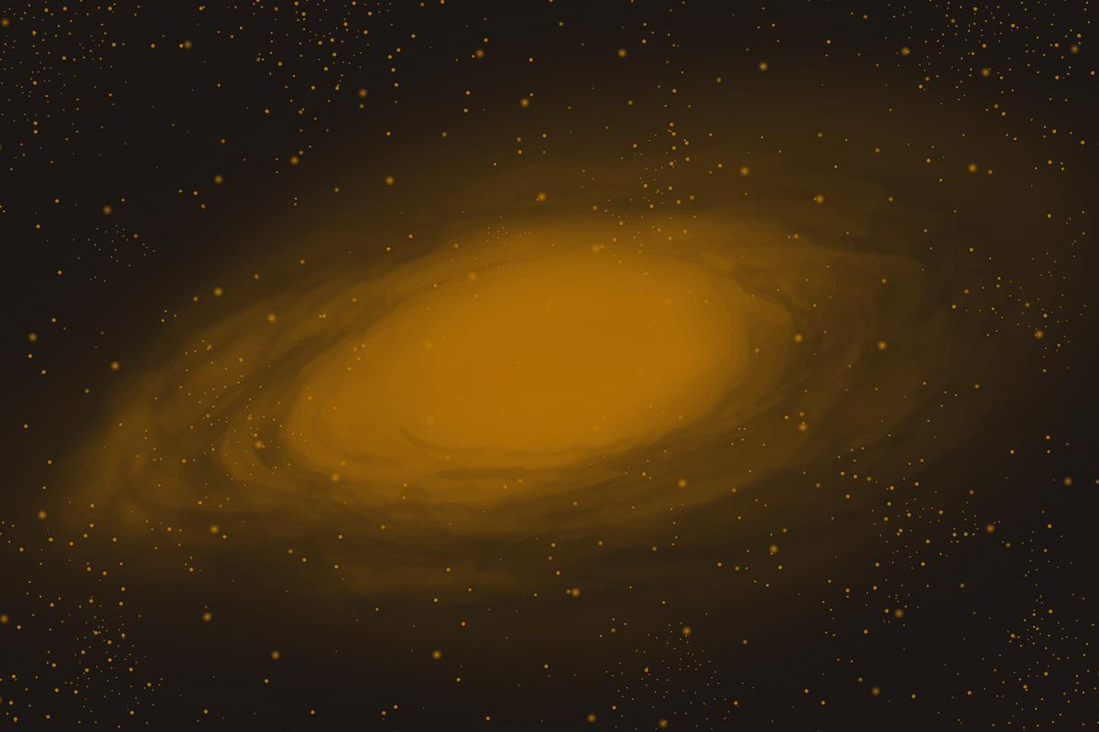
M. K. Cavanagh, K. Bekki and B. A. Groves,
“Morphological Classification of Galaxies with Deep Learning: Comparing 3-way and 4-way CNNs”
MNRAS, 506-1, 659–676 (2021).
DOI: https://doi.org/10.1093/mnras/stab1552
Notes:
.M. K. Cavanagh et al., “Morphological classification of galaxies with deep learning: comparing 3-way and 4-way CNNs”, MNRAS, 506-1, 659–676 (2021). DOI: https://doi.org/10.1093/mnras/stab1552
Monthly Notice of the royal astronomical society

Slide 5
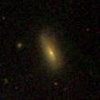
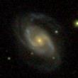
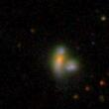
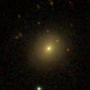
Galaxy Morphologies
Learn about:
Variety of Galaxies
Evolution History
Star Formation Rates, Scale and Mergers
Notes:
K Galaxies: Many shapes and sizes
Some pattern in the categories
Useful for :

Slide 6
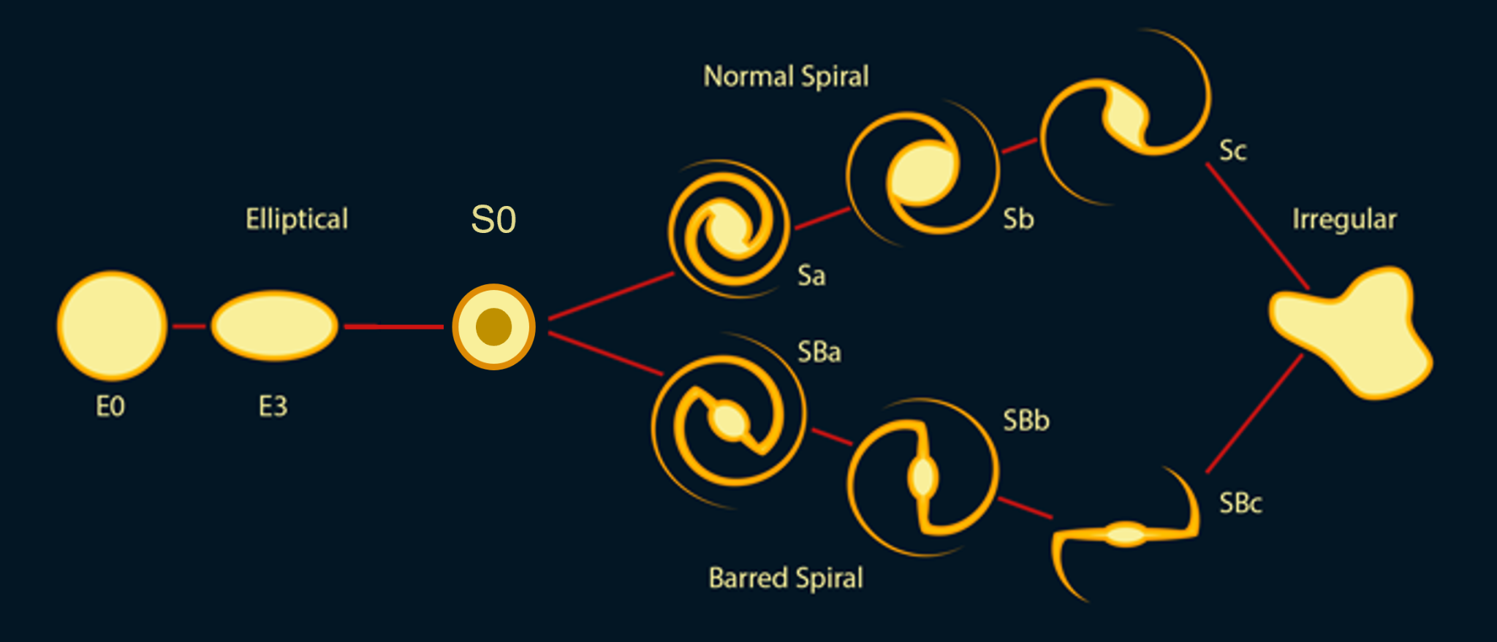
GALAXY CLASSES:
Nair et al. (2010) ApJS 186 427 DOI: 0.1088/0067-0049/186/2/427
Notes:
JORDAN
What classes?: Nair and collaborator paper classified visually with Hubble T-Type. Cavanag and collaborator put them into 4 categories: Elliptical, Lenticular, Spiral, Irregular.

Slide 7
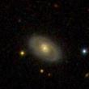
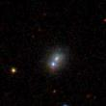
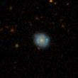
Objective: Sort Galaxies
Machine
Learning
Notes:
Classify galaxies by different types by examining their morphologies.
In the past this was done through visual inspection.
Worked in the past when a smaller set of galaxies were being observed.
Today larger sets of galaxies must be observed so this method is not sufficient.
Solution is to use machine learning methods to classify these galaxies,

Slide 8
02. DATA
Notes:
· ALEX
What is the problem tackled by your paper?
· The computational challenge the paper intends to overcome using ML
· Why CNN?
If the code of the project is available on Github or elsewhere, you must mention this in your presentation and explain how you plan to interact with that code. Will you completely ignore that code? Will you be using any parts of it to guide your development? Are you planning to develop code from scratch and/or to use alternative/improved software design compared to the existing code? How would differences between the results you'd be reproducing and what is produced in the paper play a part here? Give a justification to each such consideration.

Slide 9
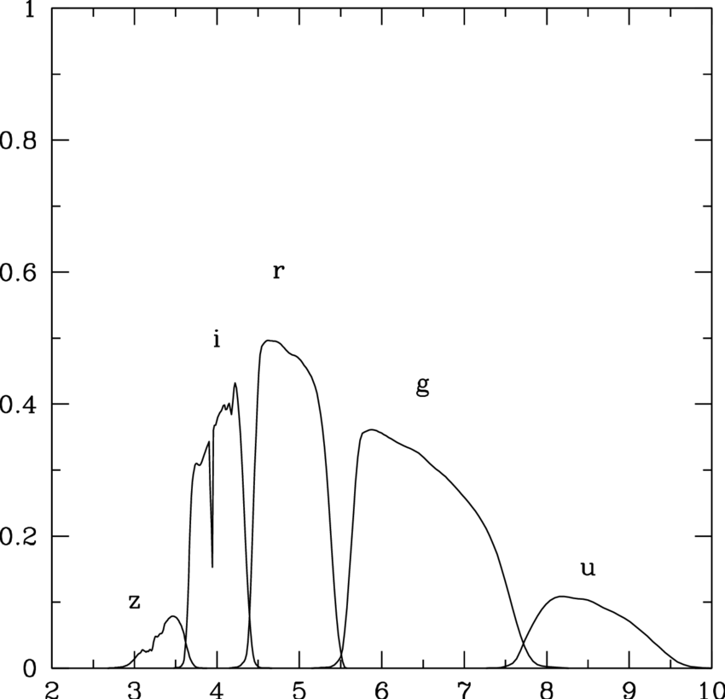

Sloan Digital Sky Survey (SDSS):
14,034 g-band Galaxy images
Notes:
Use SDSS data like in paper. Multiple bands available, use g band. A band is the wavelength range that is detected in the image. 3 different bands are shown on the right in an RGB image.
This data is classified visually by a single team Nair and colaborators

Slide 10
SDSS IMAGES
Scale: 0.7”/pixel
6’ 17”
110x110 pixels
Notes:
The paper uses SDSS data .
Access it via query system where we input the source location from the nair and collaborator catalogue.

Slide 11
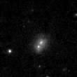
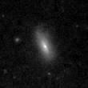
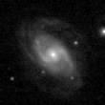
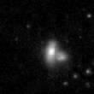
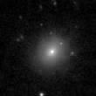
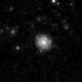
Labeled g-band Images
Irregular
Lenticular
Spiral
Irregular
Elliptical
Spiral
Notes:
qScale: 0.7” / pixels, 110x110 pixels.
Keep g-band, a single color. This is especially important since it makes morphological classification require less data. The catalogue labels is matched to the correct galaxy.

Slide 12
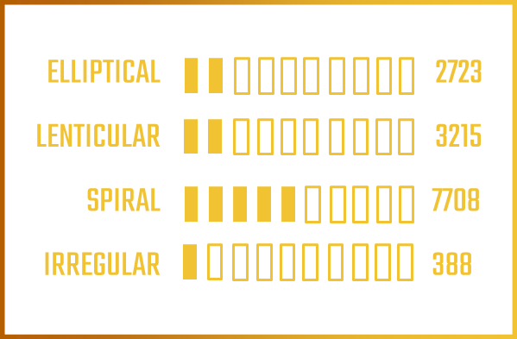
CLASSES
Notes:
End up with: these numbers. Important to note that not same amount of galaxies in each class.

Slide 13
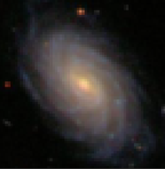
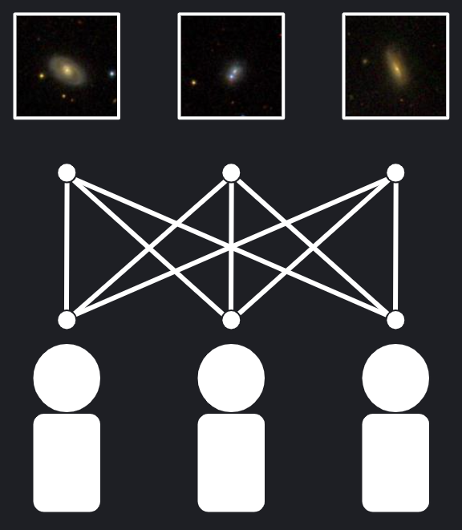
Galaxy Zoo - Galaxy 10
Crowdsourcing
10 Classes ⇒ Reduced to 4
21,785 Galaxy Images
Lower Resolution
70x70 pixels
Notes:
Other dataset we use is Galaxy zoo. A crowdsourcing based labeling of the data. Use to train too. Lower resolution images. Different labeling approach, also reduced to 4 classes.
Some of SDSS, supposed to be canfarlike
More irregular examples relative to its size

Slide 14
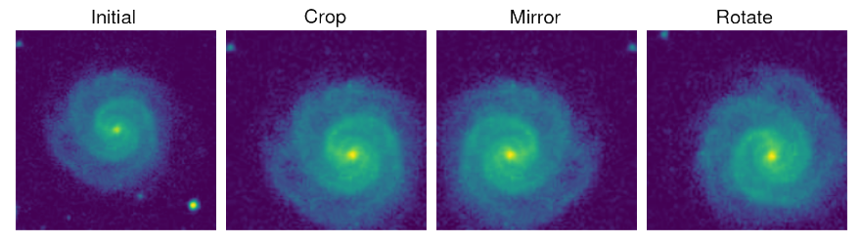
DATA AUGMENTATION
Crop image by each corner and center.
X5 more images
Rotate image by 90 deg X4 more images
Flip/mirror image on y=x axis
X2 more image
all images normalized
Notes:
JORDAN
They mention using 100 and 130 pix images and doing some cubic interpolation to resize and i think we skip that part/simplify
Did they mention random shuffle?

Slide 15
14,034 GALAXIES
561,360 Images
Classified into 4-way classes
Notes:
JORDAN

Slide 16
Memory and GPU
Problem:
Load all data at once ⇒ ⇒ Not Augmented
Small Batches ⇒ ⇒ Too Slow
Large Batch ⇒ ⇒ Google Collab
Notes:
Problem: Lots of data. Paper use GPU clusters.
Solutions: Use not augmented batch. Less accurate
Google collab: Move code to GPU, need high memory. Limited availability
Very challenging loading data, have special functions for large batch.
As result, we looked at and compared using Keras and Pytorch. We were only able to load in pytorch.

Slide 17
02. The Model

Slide 18
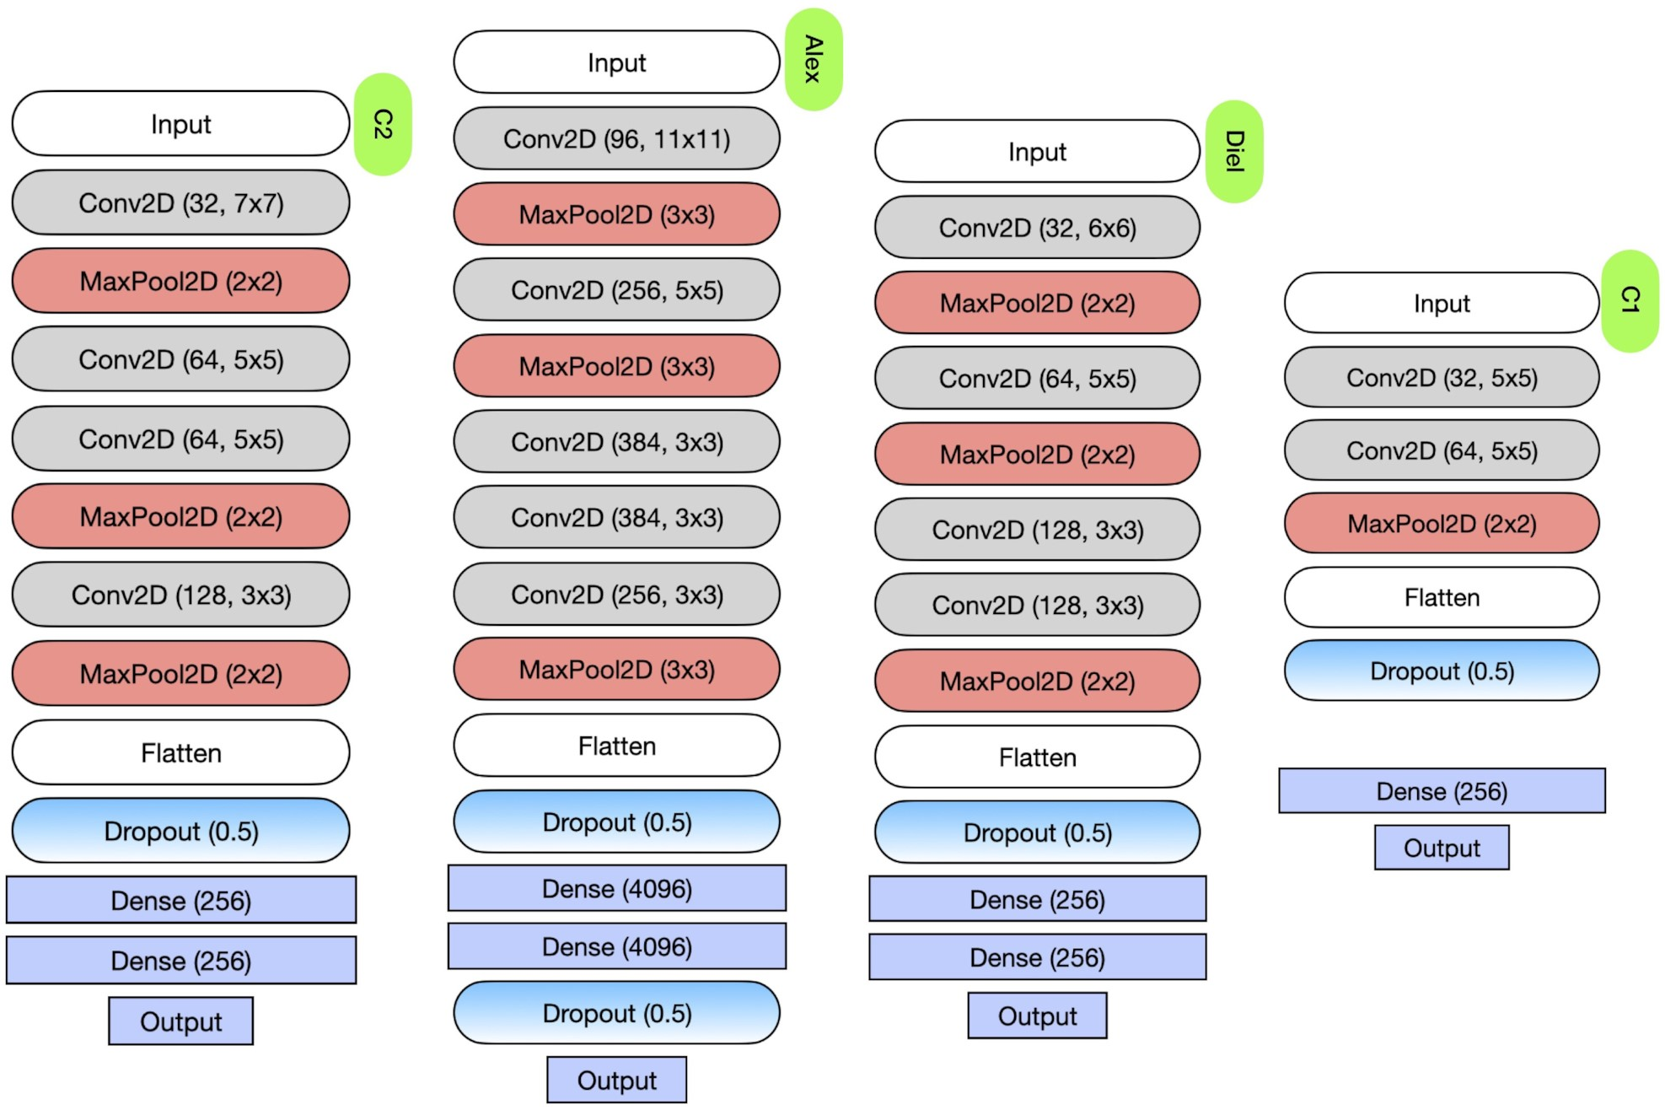
Their network, other networks, hyperparameters
Main differences between the models we are comparing, also we expect C2 to perform best
Notes:
C1 because of midterm feedback
Keras
Using C1 with adam instead of adadelta

Slide 19


Pytorch vs Keras
Paper: Cavanagh et al. use Keras
Problem: Struggle to load data batches in Keras
Solution: Implement in Pytorch and Keras
Notes:
Problem: mention using both pytorch and keras. We will show results for both with different data and augmentation.

Slide 20
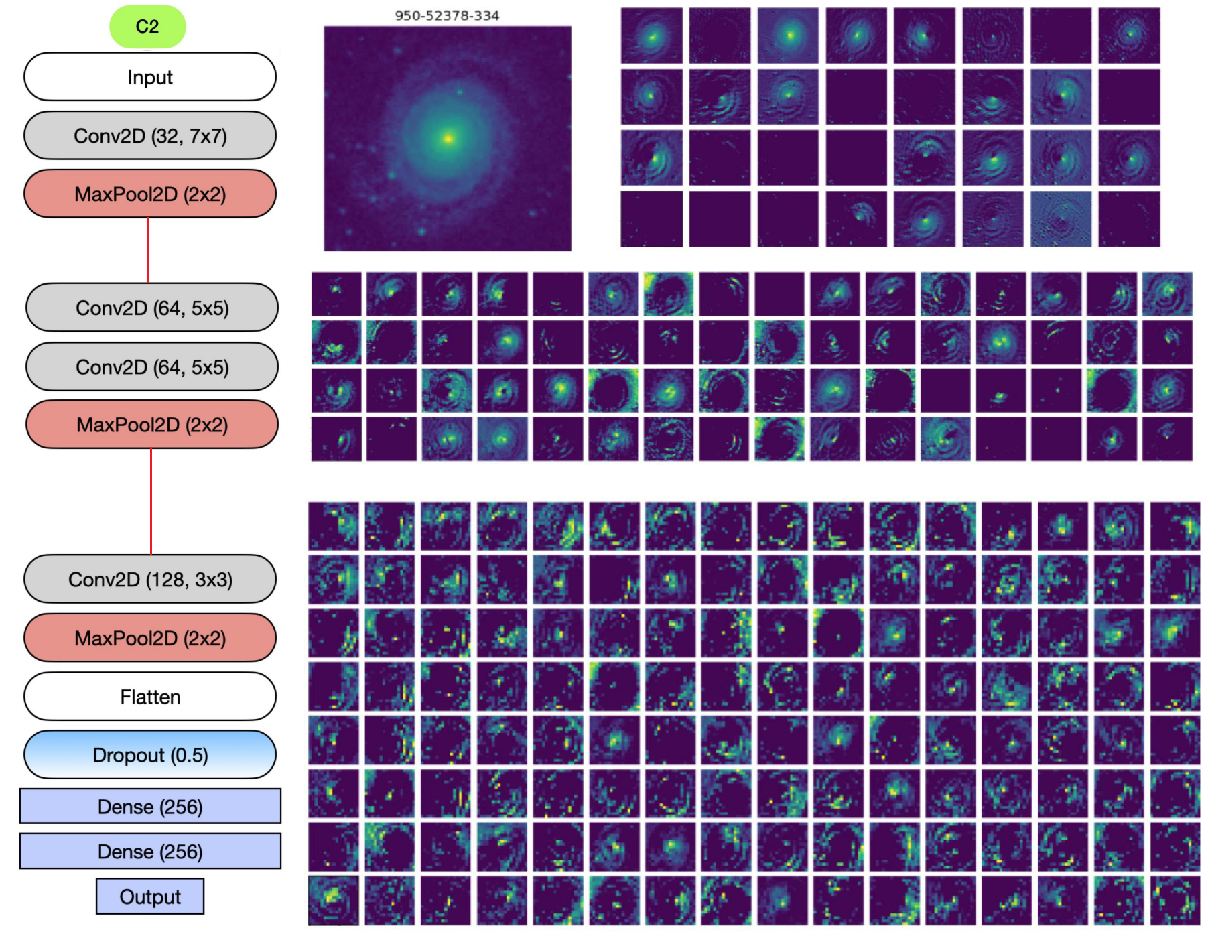

Slide 21
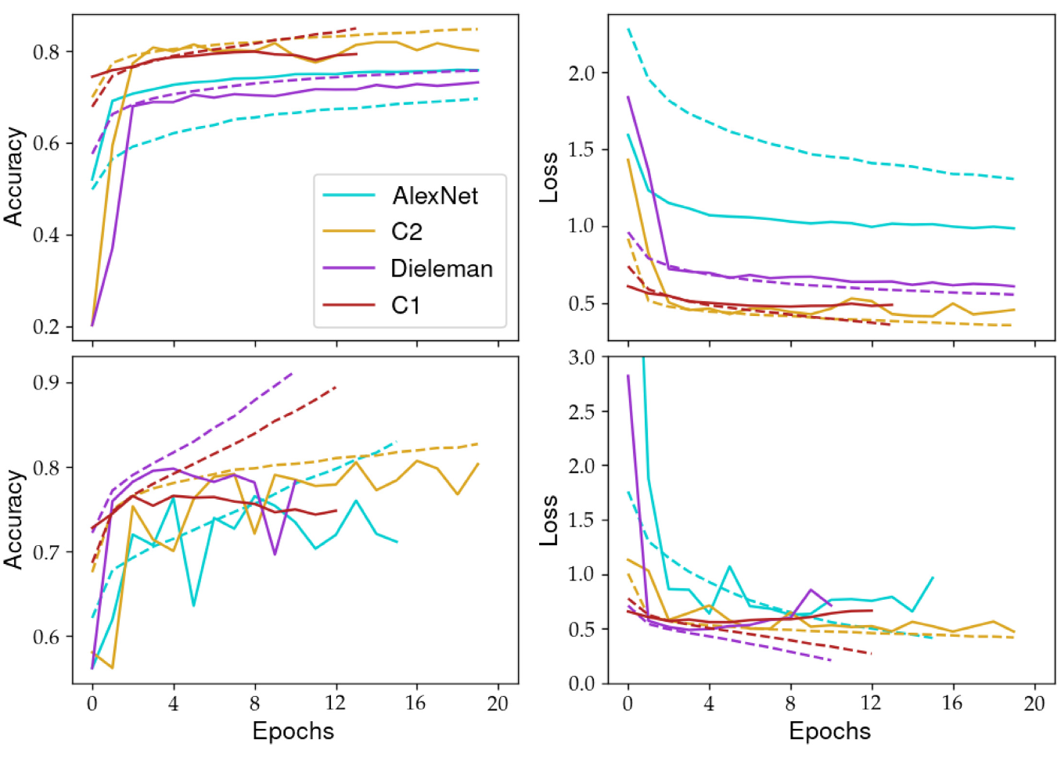
RESULTS
dashed = training
solid = validation
3-way
Early stopping used to discourage overfitting and not waste compute resources
Their network (C2) performs best on both loss and accuracy
4-way
Notes:
ASHLEY
Lines here are train and valid
Early stopping shown (able to run for 100 epochs, but all stop before then)
To conduct these runs efficiently, we used early stopping; a method of ceasing training once there is no appreciable improvement in the validation loss over a threshold number of epochs.
our C2 network is the best overall performer, since it is less affected by overfitting and achieves lower overall validation losses compared to the other models

Slide 22
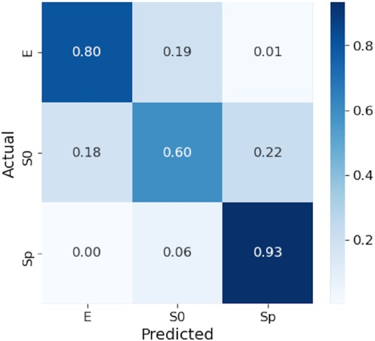
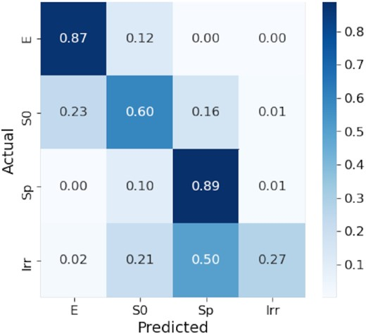
CONFUSION MATRICES
for C2, on test set
3-way classification
4-way classification
Notes:
ASHLEY (sp = spiral, s0, eliptical)
Other metrics considered like Precision, Recall, F1 and we will evaluate these but they wont be the focus, and plots if we have time
Tested on other sample (galaxy Zoo) as well, we want to do this if we have time (add)
Figure out how to mention this better (mention galaxy zoo)

Slide 23
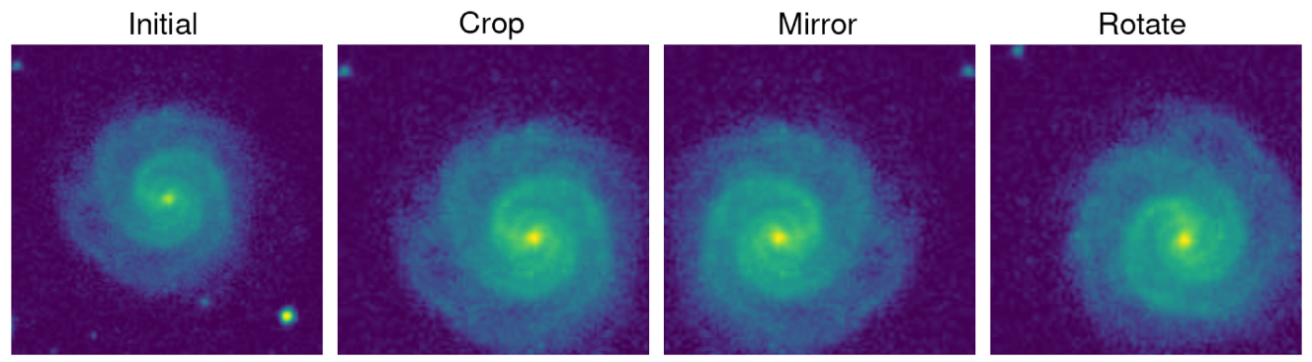
What we are not reproducing + trying to improve class weights
We are decreasing the number of augmentations we do to each image (from 40 to 5)
No mirroring and no rotating
Still have 4 crops at each corner and the initial image

Slide 24
03. RESULTS
Notes:
· ALEX
What is the problem tackled by your paper?
· The computational challenge the paper intends to overcome using ML
· Why CNN?
If the code of the project is available on Github or elsewhere, you must mention this in your presentation and explain how you plan to interact with that code. Will you completely ignore that code? Will you be using any parts of it to guide your development? Are you planning to develop code from scratch and/or to use alternative/improved software design compared to the existing code? How would differences between the results you'd be reproducing and what is produced in the paper play a part here? Give a justification to each such consideration.

Slide 25
We were planning on using keras but needed to load batches so did in pytorch to get more under the hood

Slide 26
Anything we did that differed from what they did (and maybe earlier solidify all that is the same, networks+hyperparams), used PyTorch instead of keras in the end
Our results plots next to theirs + discuss whether you have managed to successfully reproduce the numerical results and conclusions of the paper or not and provide justifications

Slide 27
Us applying it to other galaxy dataset and results from that (as analogous to what they did with galaxy zoo)

Slide 28
Rough Structure
Intro and justification for science
Data setup and augmentation (and limitations on data sizes)
This leads into the different approaches we took - for proof of concept and trial?
Keras with galaxy10 (no augmentation - simpler setup)
With 10 classes, then 4 and 3
Keras with paper data (no augmentation)
With ??
Pytorch with paper data (no augmentation)
With 4 and 3 classes
Keras with paper data (full augmentation)?
Pytorch with paper data (full augmentation)
4 and 3 classes
And we did all 5 steps with both C1 and C2?

Slide 29
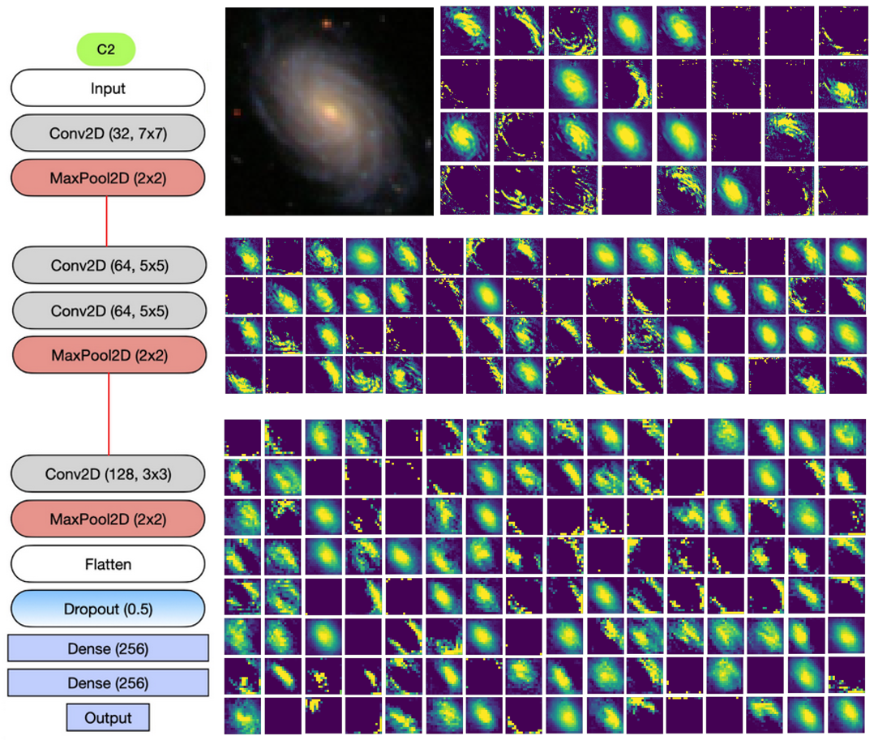
C2 Feature Maps with Galaxy10 data

Slide 30
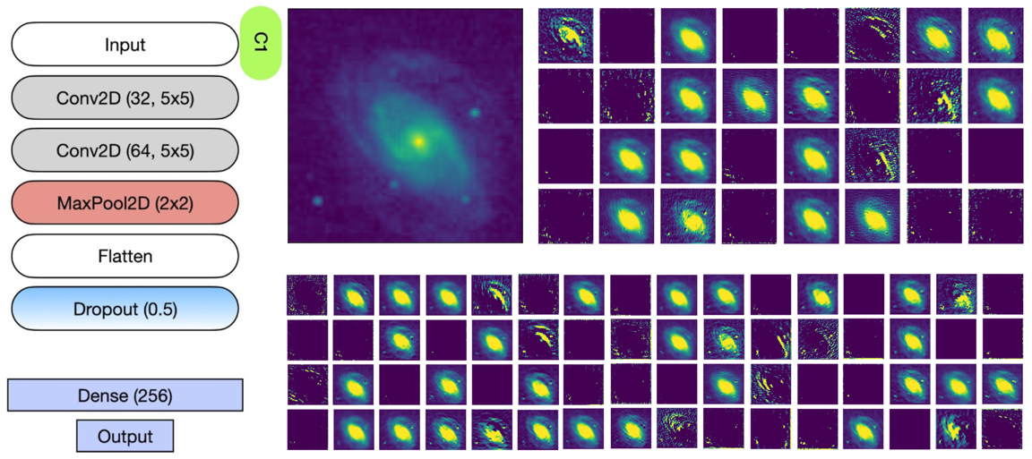
C1 Feature Maps

Slide 31
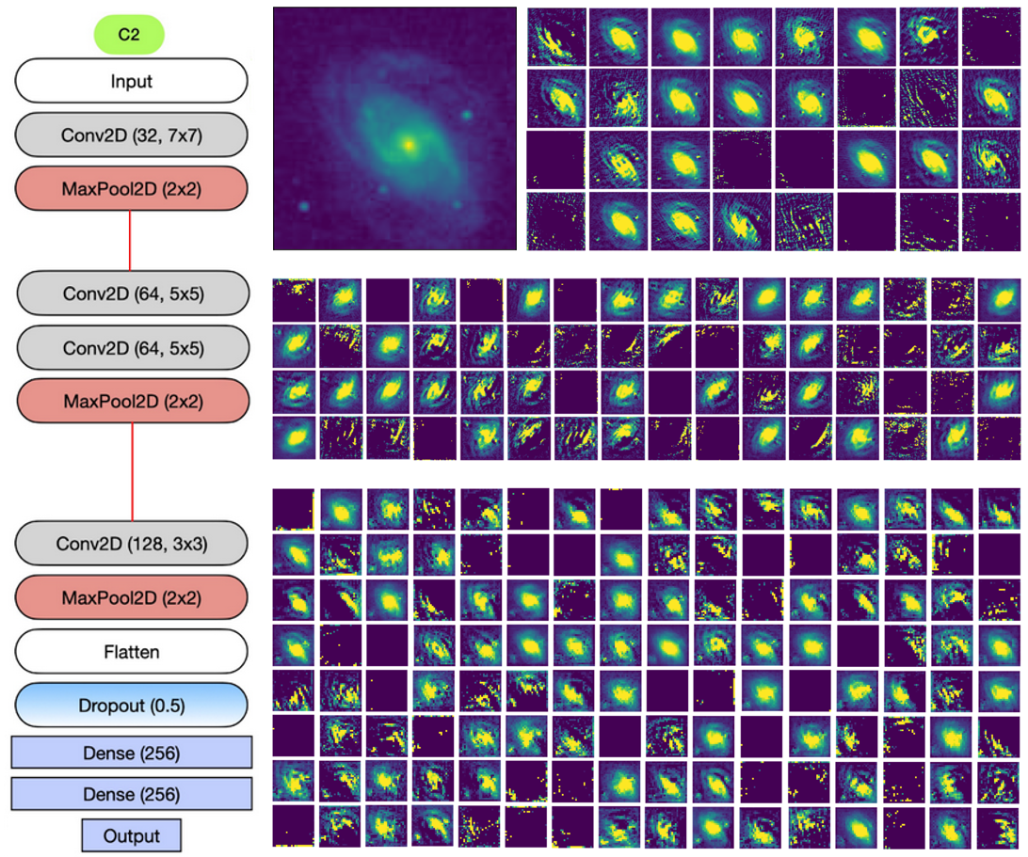
C2 Feature Maps

Slide 32
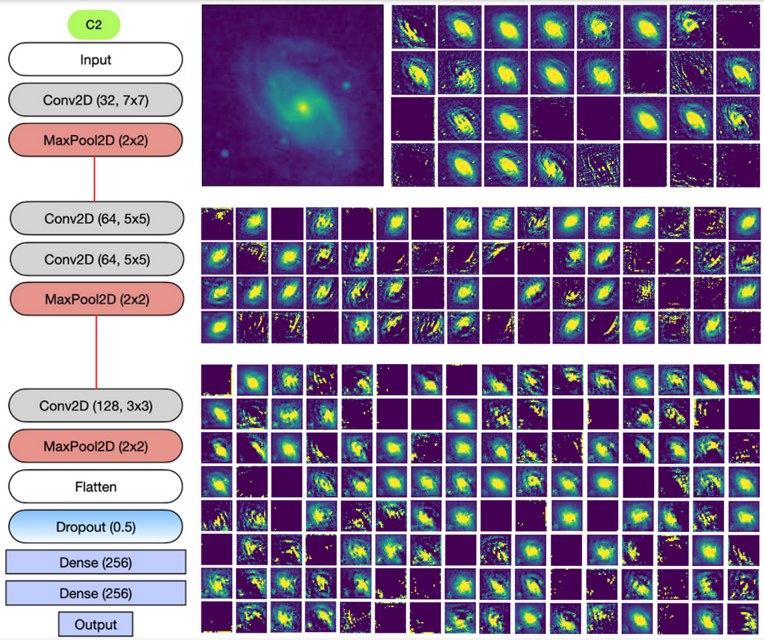
Comparison with Paper

Slide 33
04. TRAINED MODELS
Notes:
· ALEX
What is the problem tackled by your paper?
· The computational challenge the paper intends to overcome using ML
· Why CNN?
If the code of the project is available on Github or elsewhere, you must mention this in your presentation and explain how you plan to interact with that code. Will you completely ignore that code? Will you be using any parts of it to guide your development? Are you planning to develop code from scratch and/or to use alternative/improved software design compared to the existing code? How would differences between the results you'd be reproducing and what is produced in the paper play a part here? Give a justification to each such consideration.

Slide 34
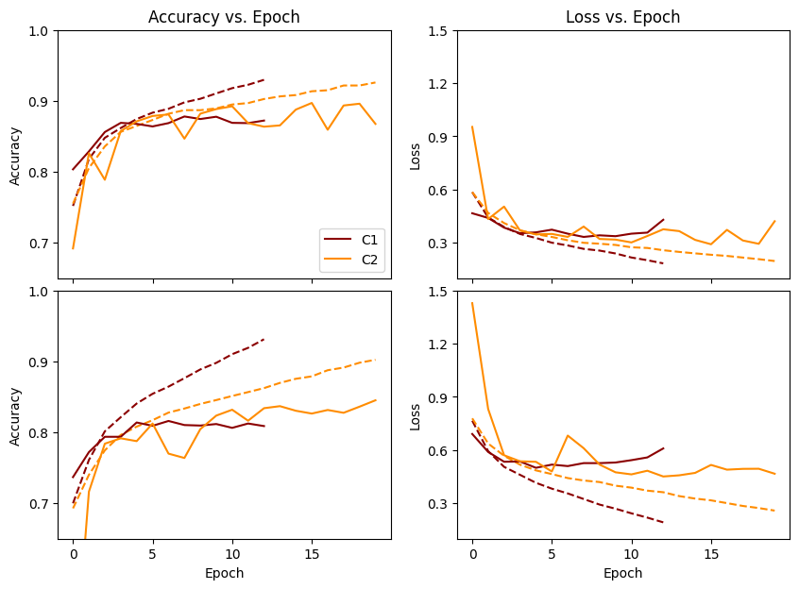
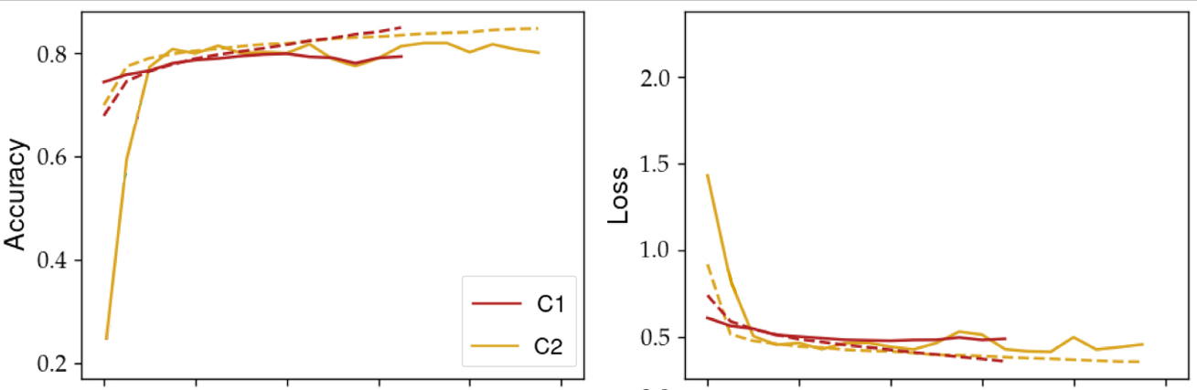
Galaxy 10 - Keras
3-Way Classification
Accuracy
Loss
Our Results
Cavanagh et al.
training
validation
0
4
8
12
16
20
0
4
8
12
16
20
Epochs
Epochs
Notes:
Mention c1 using adam and same lr (tell yusuf), assumed
Mention just g band
Maybe not need as much data
Caveat the (85/15)/15
Add lr
4 way is better
Make more visible
Break this up into 3 and 4 way and then make newer slides, make new plots
Yellow dadarker or orange

Slide 35
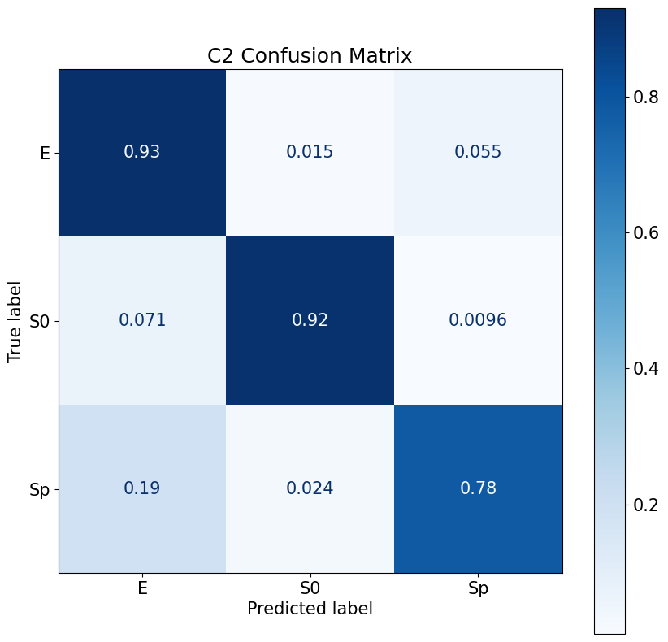
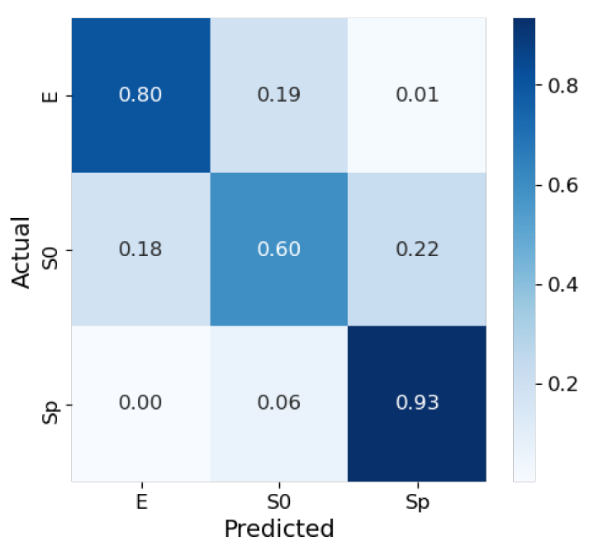
Galaxy 10 - Keras
C2
Cavanagh et al.
Our Results
Notes:
ASHLEY (sp = spiral, s0, eliptical)
Other metrics considered like Precision, Recall, F1 and we will evaluate these but they wont be the focus, and plots if we have time
Tested on other sample (galaxy Zoo) as well, we want to do this if we have time (add)
Figure out how to mention this better (mention galaxy zoo)

Slide 36
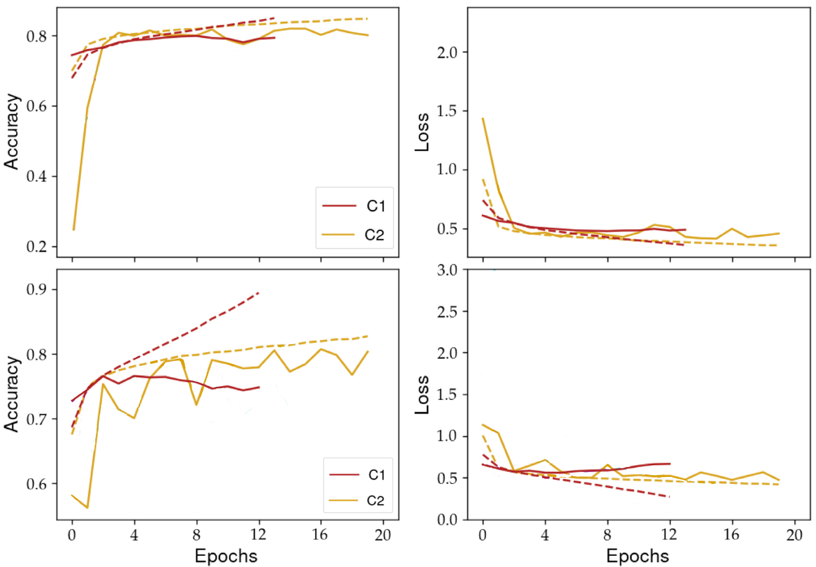
Galaxy 10 - Keras
4-Way Classification
Accuracy
Loss
Our Results
Cavanagh et al.
training
validation
0
4
8
12
16
20
0
4
8
12
16
20
Epochs
Epochs
Notes:
Mention c1 using adam and same lr (tell yusuf), assumed
Mention just g band
Maybe not need as much data
Caveat the (85/15)/15
Add lr
4 way is better
Make more visible
Break this up into 3 and 4 way and then make newer slides, make new plots
Yellow dadarker or orange

Slide 37
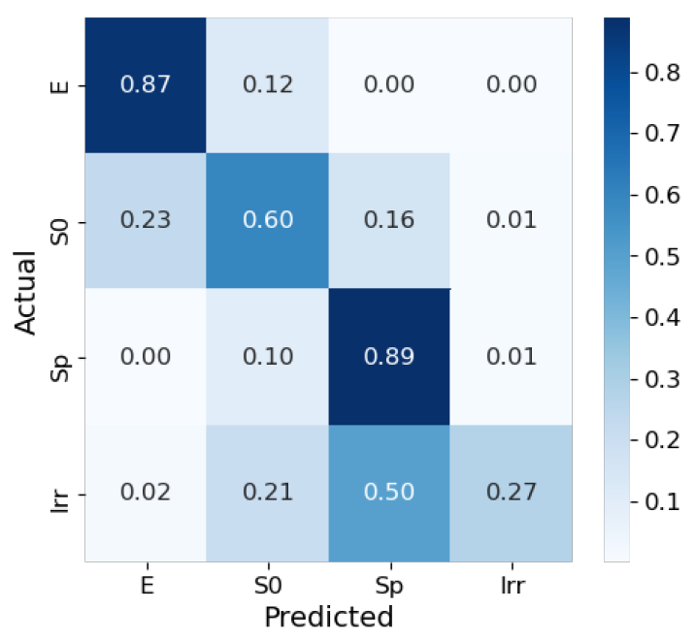
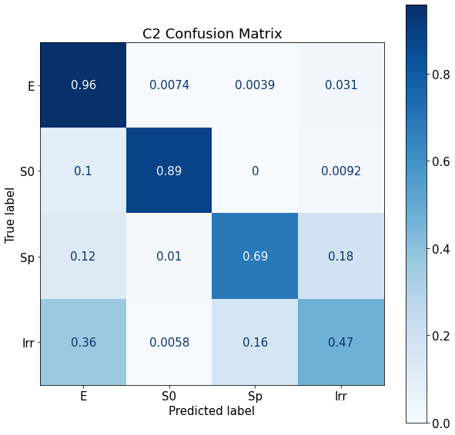
Galaxy 10 - Keras
C2
Cavanagh et al.
Our Results
Notes:
ASHLEY (sp = spiral, s0, eliptical)
Other metrics considered like Precision, Recall, F1 and we will evaluate these but they wont be the focus, and plots if we have time
Tested on other sample (galaxy Zoo) as well, we want to do this if we have time (add)
Figure out how to mention this better (mention galaxy zoo)

Slide 38
SDSS - Keras
4-Way Classification
Accuracy
Loss
Our Results
Cavanagh et al.
training
validation
0
4
8
12
16
20
0
4
8
12
16
20
Epochs
Epochs
Notes:
Mention c1 using adam and same lr (tell yusuf), assumed
Mention just g band
Maybe not need as much data
Caveat the (85/15)/15
Add lr
4 way is better
Make more visible
Break this up into 3 and 4 way and then make newer slides, make new plots
Yellow dadarker or orange

Slide 39
SDSS - Keras
C2
Cavanagh et al.
Our Results

Slide 40
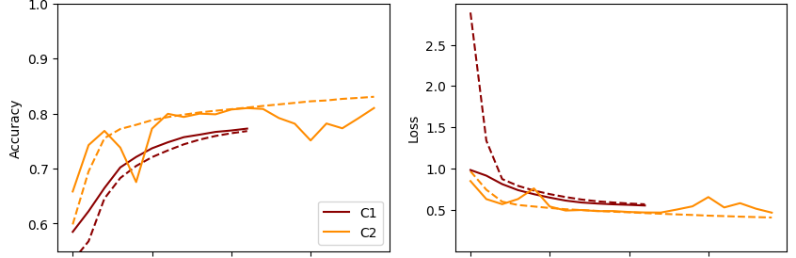
SDSS - Pytorch
4-Way Classification
Accuracy
Loss
Our Results
Cavanagh et al.
training
validation
0
4
8
12
16
20
0
4
8
12
16
20
Epochs
Epochs
Notes:
Mention c1 using adam and same lr (tell yusuf), assumed
Mention just g band
Maybe not need as much data
Caveat the (85/15)/15
Add lr
4 way is better
Make more visible
Break this up into 3 and 4 way and then make newer slides, make new plots
Yellow dadarker or orange

Slide 41
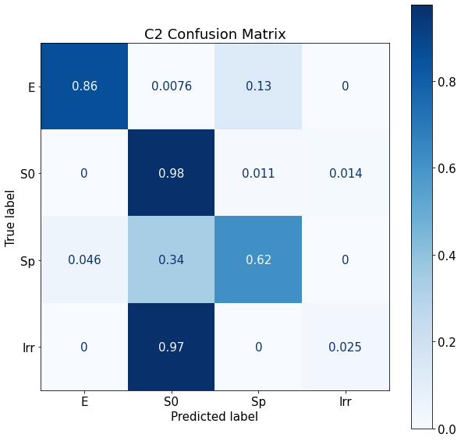
SDSS - Pytorch
C2
Cavanagh et al.
Our Results

Slide 42
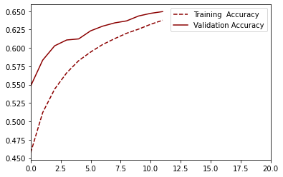
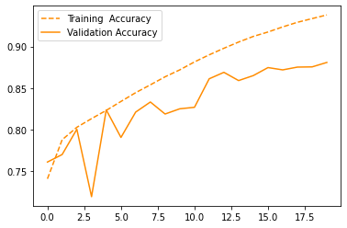
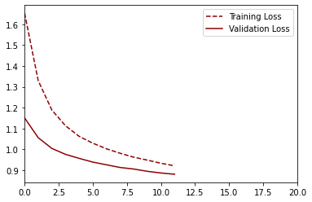
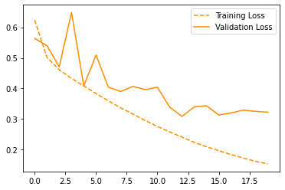
Keras
Cavanagh et al.
Our Results
(300,000 images)
(561,360 images)
C1
C2

Slide 43
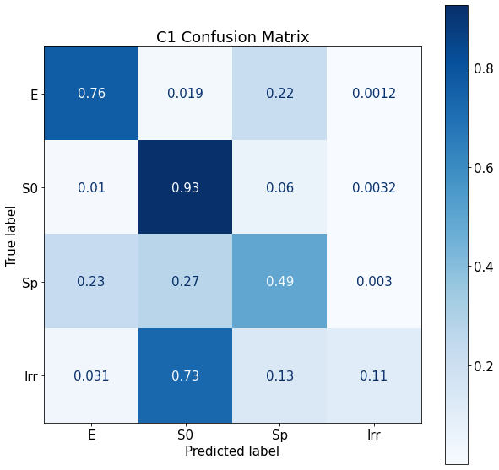
Keras
for C1 4-way classification, on test set
Cavanagh et al.
Our Results
(561,360 images)
(300,000 images)

Slide 44
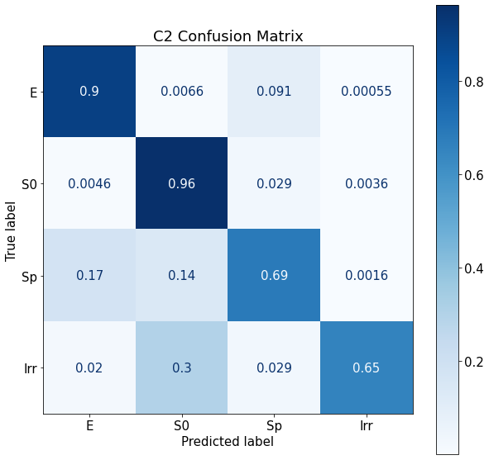
Keras
for C2 4-way classification, on test set
Cavanagh et al.
Our Results
(561,360 images)
(300,000 images)

Slide 45
04. CONCLUSIONS
Notes:
We did for SDSS data cm and acc taken from validation set no serpeate test set, augmented verisons of what we trained on, can be in there (seems like this would have been similar to what they did but did they use galaxy zoo for cm? Different size?)
A couple discrepancies on model structure

Slide 46
Overall Results
Network | #-Way | Data | Augment | Framework | Accuracy
C1 | 3 | G10 | No | Keras | 87%
 | 4 |  |  |  | 80%
 |  | Paper | Half |  | 65%
 |  |  | Full |  | 75%
 |  |  |  | Pytorch | 77%
C2 | 3 | G10 | No | Keras | 88%
 | 4 |  |  |  | 84%
 |  | Paper | Half |  | 88%
 |  |  | Full |  | 81%
 |  |  |  | Pytorch | 81%
Cavanagh et al.
Cavanagh et al.
Notes:
C1 G10 better: C1 overall better because using Adam optimizer. Bad results with adadelta (they dont specify hyperparems)
G10 has more irregular galaxies so does better.
0.0004 vs 0.0002 learning rate: 4way keras C2 ours
Explain what your results mean and what are the resultant answers to the questions asked and investigated in the paper
Deeper generally better, adam generally better, more epochs generally better
1 channel seems to be enough to get some results

Slide 47
Reproduced Results
Networks:
AlexNet
Dieleman
C1
C2
# of Class:
2 Way
3 Way
4 Way
Galaxy Zoo Test:
Extra:
Pytorch
Keras
Galaxy 10 Train
Feature Maps:

Slide 48
05. OUTLOOK
Notes:
· ALEX
What is the problem tackled by your paper?
· The computational challenge the paper intends to overcome using ML
· Why CNN?
If the code of the project is available on Github or elsewhere, you must mention this in your presentation and explain how you plan to interact with that code. Will you completely ignore that code? Will you be using any parts of it to guide your development? Are you planning to develop code from scratch and/or to use alternative/improved software design compared to the existing code? How would differences between the results you'd be reproducing and what is produced in the paper play a part here? Give a justification to each such consideration.

Slide 49
Future Directions
Is Simple Better?
Data Driven Labels?
Balance classes, more rigorous testing
Augmentation, regularization, g-band
Rethink old morphology classification schemes
Notes:
Possible Improvements
Random seed

Slide 50
Availability
Code ⇒ /networks
Models ⇒ /results
Data ⇒ /data
Notes:
· ALEX
What is the problem tackled by your paper?
· The computational challenge the paper intends to overcome using ML
· Why CNN?
If the code of the project is available on Github or elsewhere, you must mention this in your presentation and explain how you plan to interact with that code. Will you completely ignore that code? Will you be using any parts of it to guide your development? Are you planning to develop code from scratch and/or to use alternative/improved software design compared to the existing code? How would differences between the results you'd be reproducing and what is produced in the paper play a part here? Give a justification to each such consideration.

Slide 51

GitHub Repo:
github.com/ashley-ferreira/PHYS449
Notes:
ASHLEY

Slide 52
QUESTIONS & DISCUSSION
Thank you for your time and feedback
Notes:
ASHLEY
Main feedback: implement another one of the models (I’m thinking C1), touch more on why ML needed and why adam not used in on other models (I think we touch on this again in our final presentation), more detailed timeline needed with other tasks for people not just to support

Slide 53
Outstanding things
Clean up github repository (make good readme w/ contributions + in general good code and documentation)
“Your repository should be easy to navigate in and your readme.md files should clearly explain the structure of the repository”
Send him github+invite him, send him slides
No commits after midnight day before our presentation
Plan to have more than a notebook? Put into files if we have time
Save model to github
dry runs of presentations, everyone get there early morning of
Notes:
We did SDSS results on validation instead of separate test and augmented

Slide 54
Overview of Appendix Slides
Hyperparameters
3-Way CMs
Galaxy 10 Results
Detailed list
3-way Classification Confusion Matrices
3-way and 4-way Classification Training

Slide 55
Hyperparameters
Unless otherwise noted, for both C1 & C2 in both Keras & PyTorch:
Optimizer: Adam
Learning Rate: 2e-4
Dropout: 0.5
Notes:
Unless otherwise noted, f

Slide 56
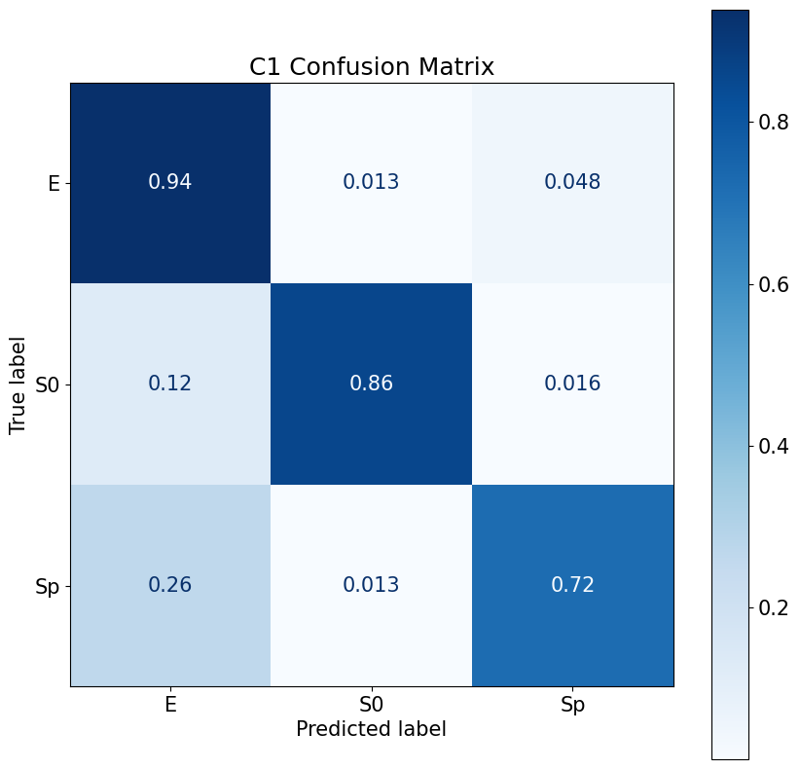
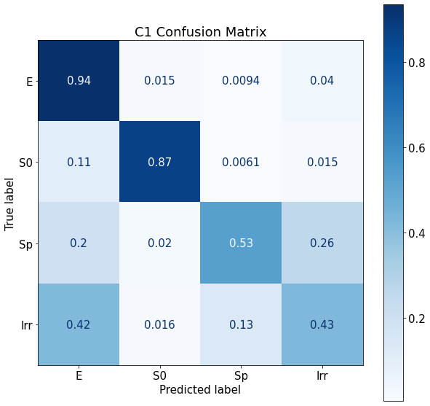
Galaxy 10 Data - Keras
for C1 classification, on test set
Our Results 3-Way
Our Results 4-Way
Notes:
ASHLEY (sp = spiral, s0, eliptical)
Other metrics considered like Precision, Recall, F1 and we will evaluate these but they wont be the focus, and plots if we have time
Tested on other sample (galaxy Zoo) as well, we want to do this if we have time (add)
Figure out how to mention this better (mention galaxy zoo)

Slide 57
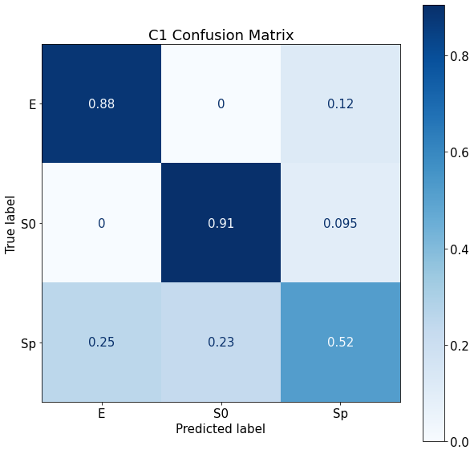
PyTorch
for C1 3-way classification, on test set
Cavanagh et al.
Our Results
Notes:
“Approximate cm” 2000, not trained on

Slide 58
Galaxy10 Data - Keras
3-way
4-way
Notes:
Axis is not the same for both ours and theirs but not same data so we don’t expect the same but we do expect the same trend
Mention c1 using adam and same lr (tell yusuf), assumed
Mention just g band
Maybe not need as much data
Caveat the (85/15)/15
Add lr
4 way is better
Make more visible
Break this up into 3 and 4 way and then make newer slides, make new plots
Yellow dadarker or orange

